Slide 1
CGB1201 – JAVA PROGRAMMING
Department of Artificial Intelligence and Data Science
Academic Year: 2024 – 2025 (Odd Semester)
Register Number :2303811724322093
Name :SAHANA.P
Year :II
Semester :III
Section :AIDS-B
Date :03-12-2024

Slide 2
Title of the Project
EXAM MANAGEMENT SYSTEM

Slide 3
Problem Identification
Traditional systems involve manual processes prone to human errors in scheduling and grading.
Difficulty in managing exam schedules, avoiding conflicts, and optimizing resources.
Limited access to real-time exam information and poor communication between students and faculty.

Slide 4
Objective
It is to automate the scheduling, grading, and result processing of exams to reduce errors and inefficiencies. It aims to provide a centralized platform for students, faculty, and administrators to manage exams, track performance, and receive real-time updates. Additionally, the system ensures secure handling of data, offers a user-friendly interface, and integrates with other educational systems for a comprehensive experience.

Slide 5
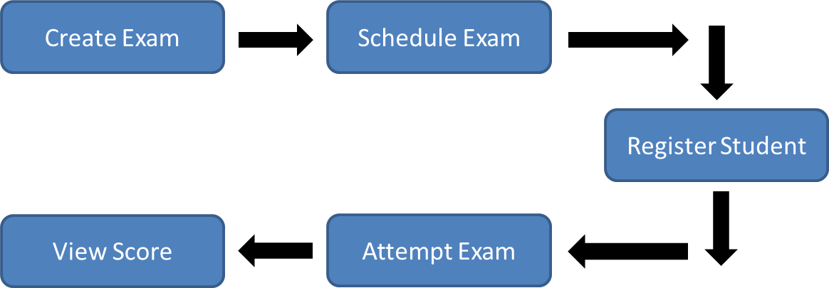
Proposed Architecture

Slide 6
Java Programming - Concepts Used
Swing Framework
Event Handling
Object-Oriented Programming (OOP)
Collections Framework

Slide 7
List of Modules
Login Module
Exam Management Module
Student Result Module
Result Viewing Module

Slide 8
Module Description
1.Login Module: Ensures secure access with credentials (admin/admin).
2.Exam Management Module: Allows adding new exams with attributes like name and date.
3.Student Result Module: Enables adding student scores for specific exams.
4. Result Viewing Module: Facilitates viewing all results for a specified exam.

Slide 9
Source Code
import javax.swing.*;
import java.awt.*;
import java.awt.event.*;
import java.util.ArrayList;
// Main EMS Class
public class EMS {
private JFrame frame;
private JTextArea textArea;
private ArrayList<Exam> exams;
private ArrayList<Student> students;

Slide 10
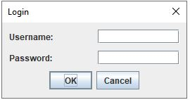
Results
Login:

Slide 11
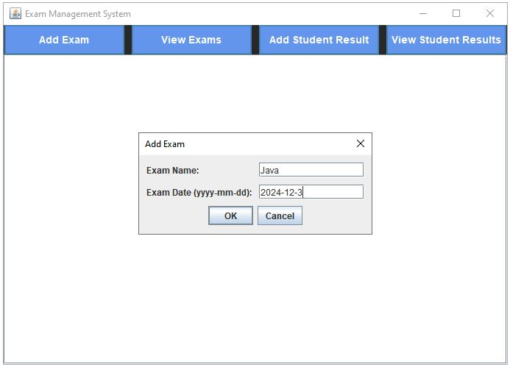
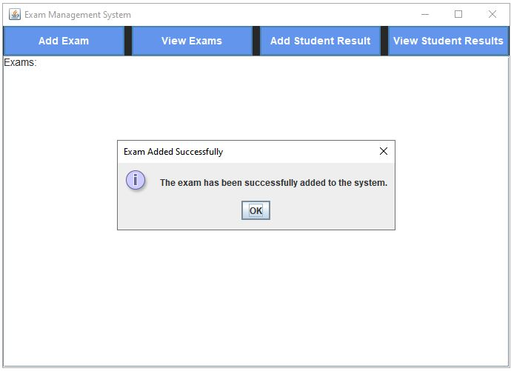
Results
Add Exams:

Slide 12
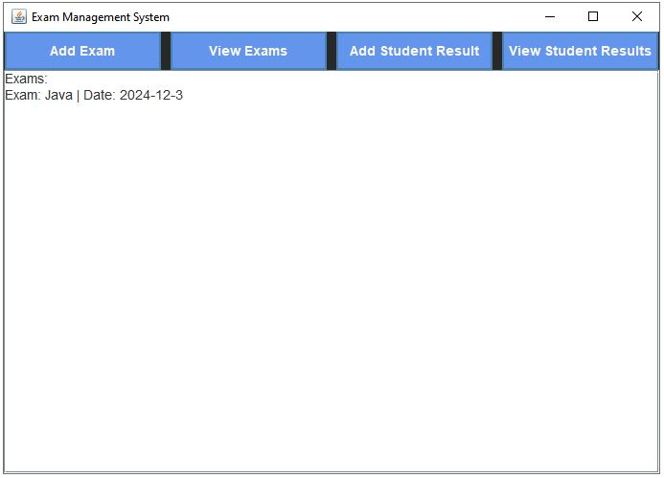
Results
View Exam:

Slide 13
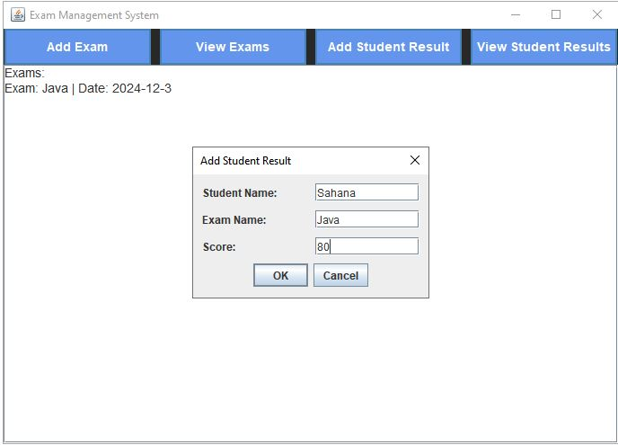
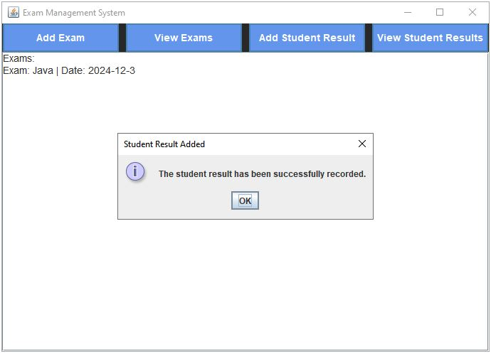
Results
Add Student Results:

Slide 14
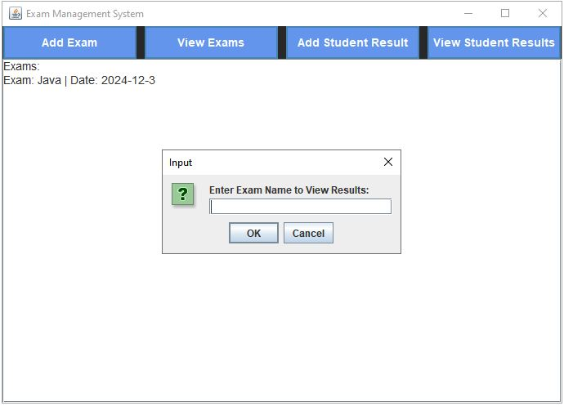
Results
View Student Results:

Slide 15
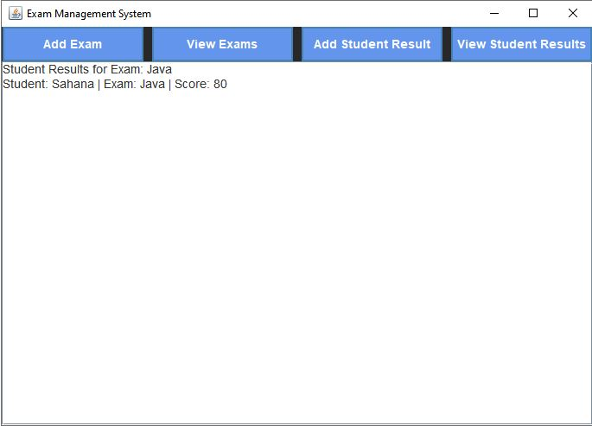
Results
Result:

Slide 16
Conclusion
The Exam Management System successfully integrates GUI, event-driven programming, and core Java concepts to offer an efficient solution for managing exams and student results. Its modular architecture ensures scalability and maintainability, making it a valuable tool for educational institutions. Future enhancements could include database integration, multi-user support, and advanced analytics for performance tracking.

Slide 17
Thank You
Any queries???

